Slide 1
IBM Data Science Capstone: Implementation of a Data Science Analysis for the location of a new Hotel in Bogota.
Juan Pablo Mendoza.
January 26, 2020.

Slide 2
1. Introduction
In recent years Bogota, capital city of Colombia, has been subject of a rise in both foreign investment and inner economic development, which is precisely why, when faced with the question of where to install a new hotel, it is very important to know the characteristics of interest in the sector to locate the investment.

Slide 3
2. Data
In order to make a proper analysis over the different sectors in which to establish the new hotel, it will be required to separate the city into different locations and inspect the venues surrounding each of them. For this purpose the data concerning the locations will be scrapped from the official subdivisions of localities that can be found in the following link.
For the venues in each subdivision the data will be taken from the Foursquare database using a developer account.

Slide 4
3. Results
The clustering algorithm provided three different clusters with different frequencies, most notable changes may be seen in the food and entertainment related vanues.

Slide 5
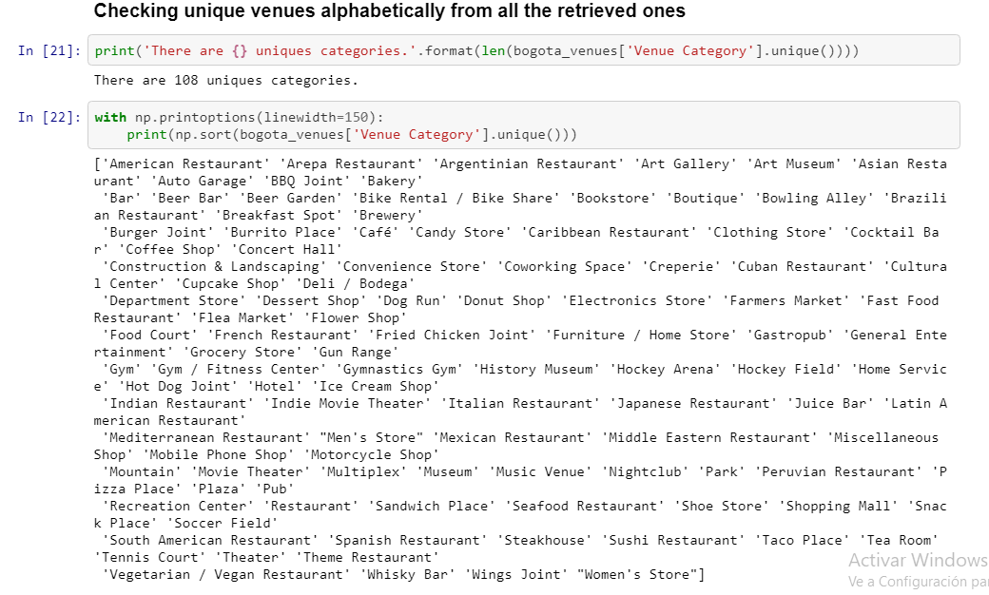

Slide 6
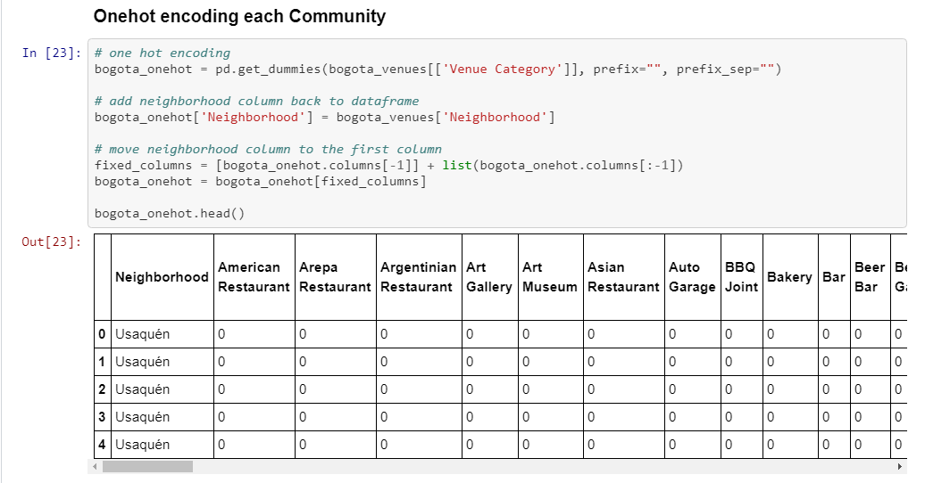

Slide 7
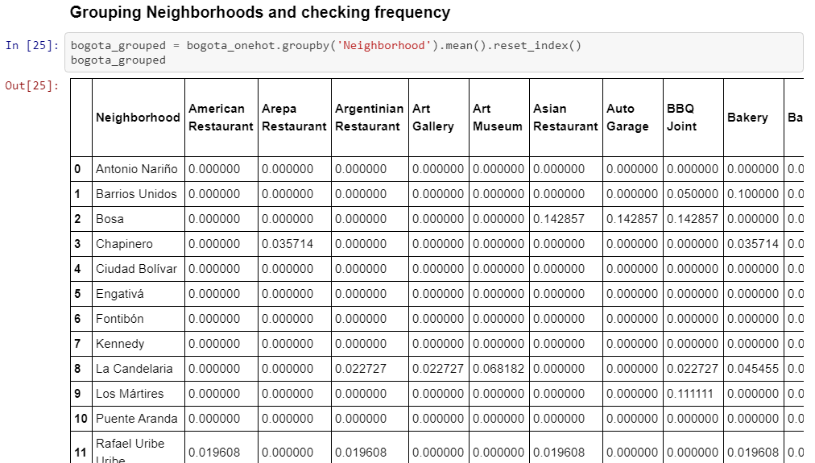

Slide 8
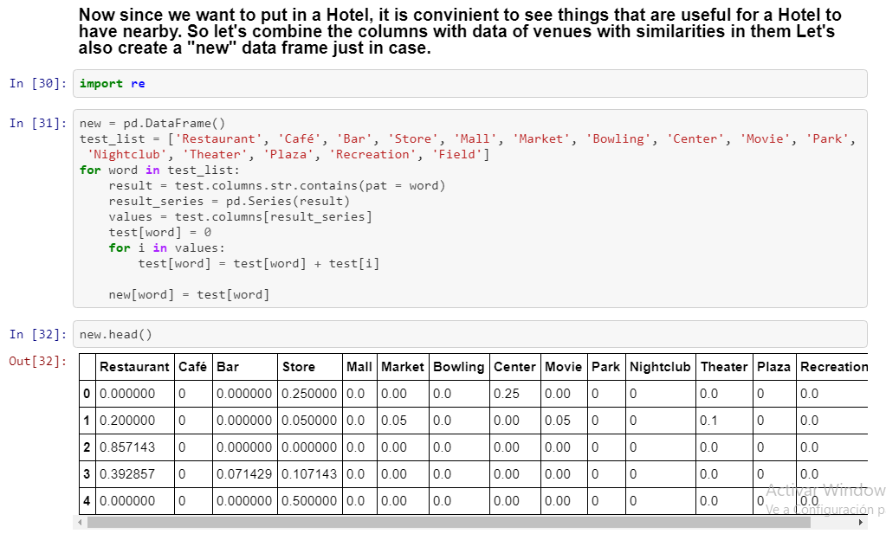

Slide 9
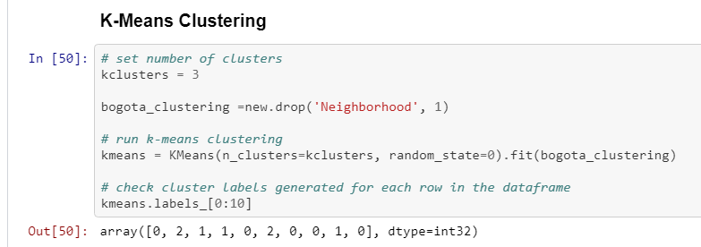

Slide 10
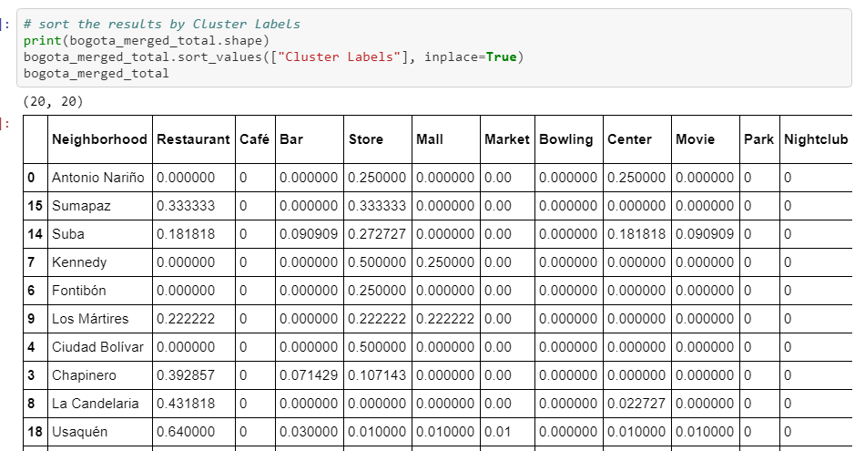

Slide 11
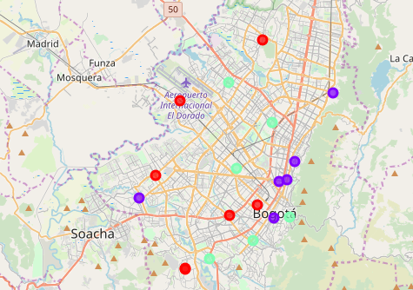
Red = Cluster #0
Purple = Cluster #1
Green Cyan = Cluster #2

Slide 12
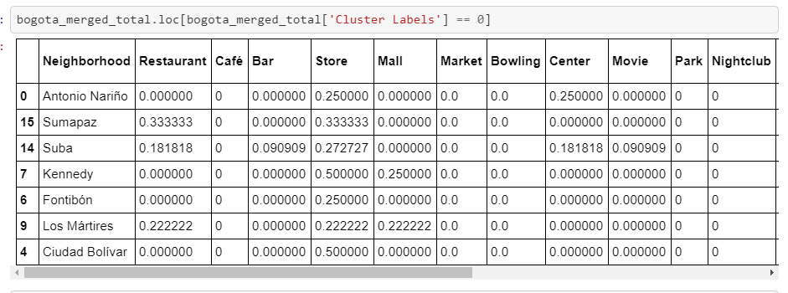
Cluster #0

Slide 13
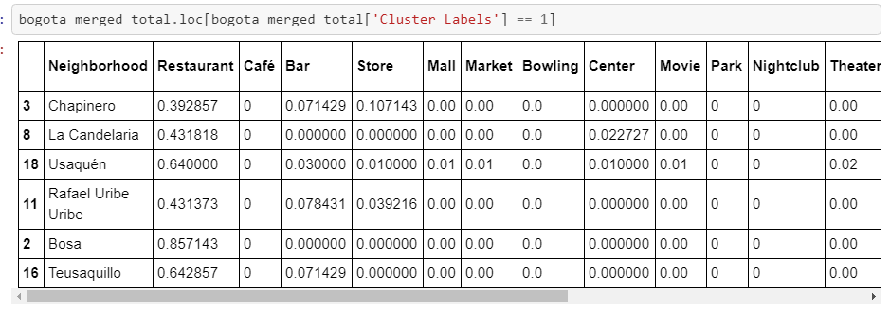
Cluster #1

Slide 14
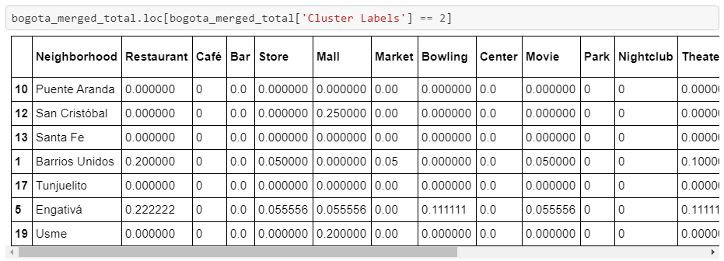
Cluster #2

Slide 15
4. Conclusion.
The clustering algorithm, with the help of the Foursquare database has provided 3 different clusters involving the 20 localities of Bogota, Colombia. As it can be seen from the segmentation of each cluster, the localities in Cluster No. 0 seem to have slightly more presence of cultural and entertainment facilities in comparison with the other clusters. Cluster No. 1 has a significantly higher presence of restaurants and food-related businesses compared to the other clusters. Lastly, Cluster No. 2 seems to be rather empty.
In conclusion, even though Cluster No. 0 does seem to provide more entertainment facilities, it is a slight difference compared to Cluster No. 1, which in turn has a significant upper-hand in restaurants and similar businesses. Therefore, in regards to the positioning of a new Hotel, Cluster No. 1 is the recmomended option.

